Slide 1
Day 5

Slide 2
Data Source File
https://drive.google.com/drive/folders/1xcmHEYOB0clh54Y4-3EqEd0Fz8X8KYDk

Slide 3
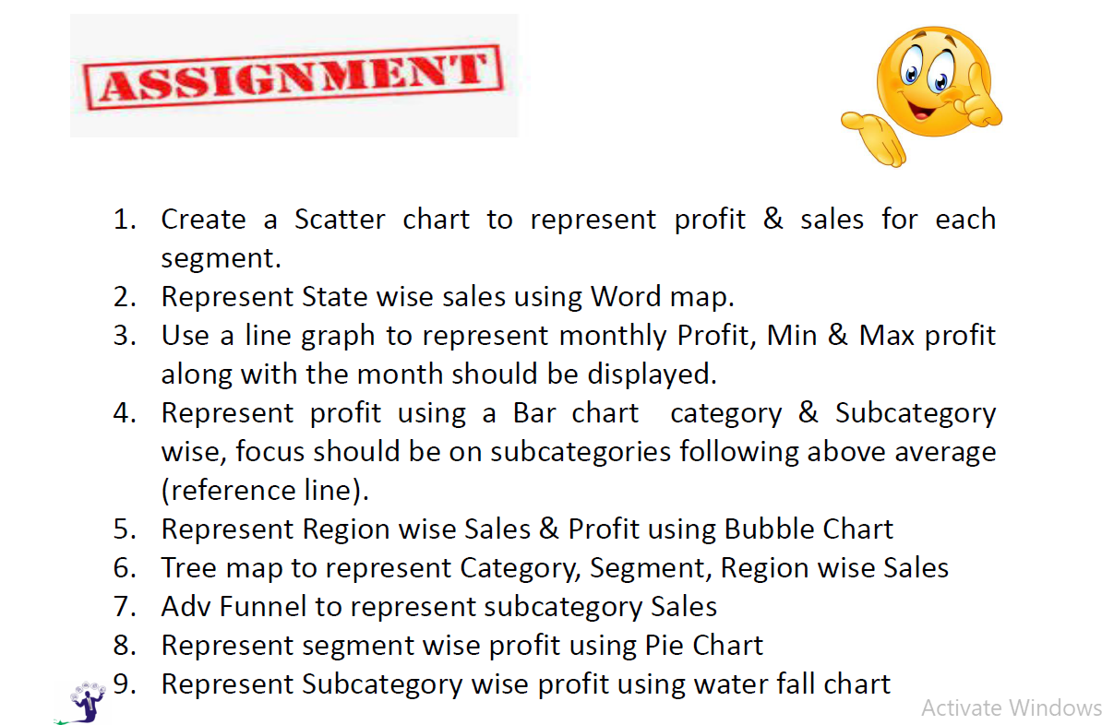
Questions:

Slide 4
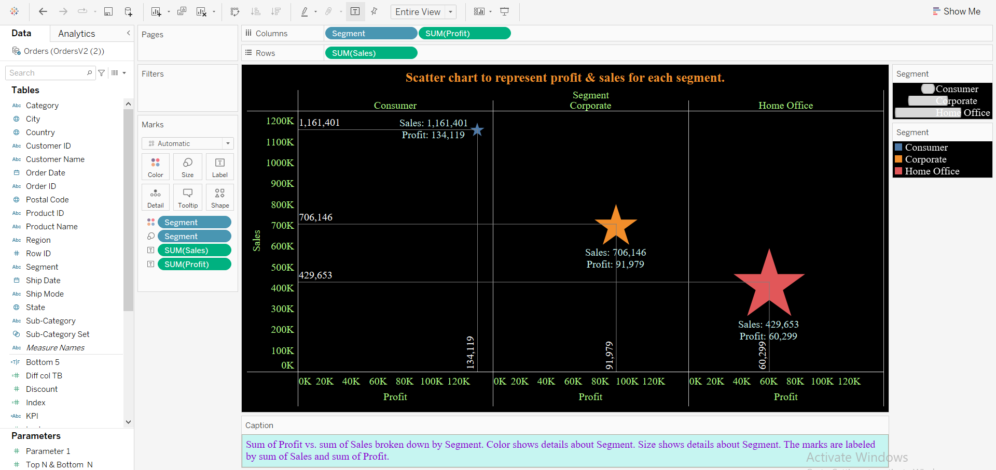
Scatter chart to represent profit & sales for each segment.

Slide 5
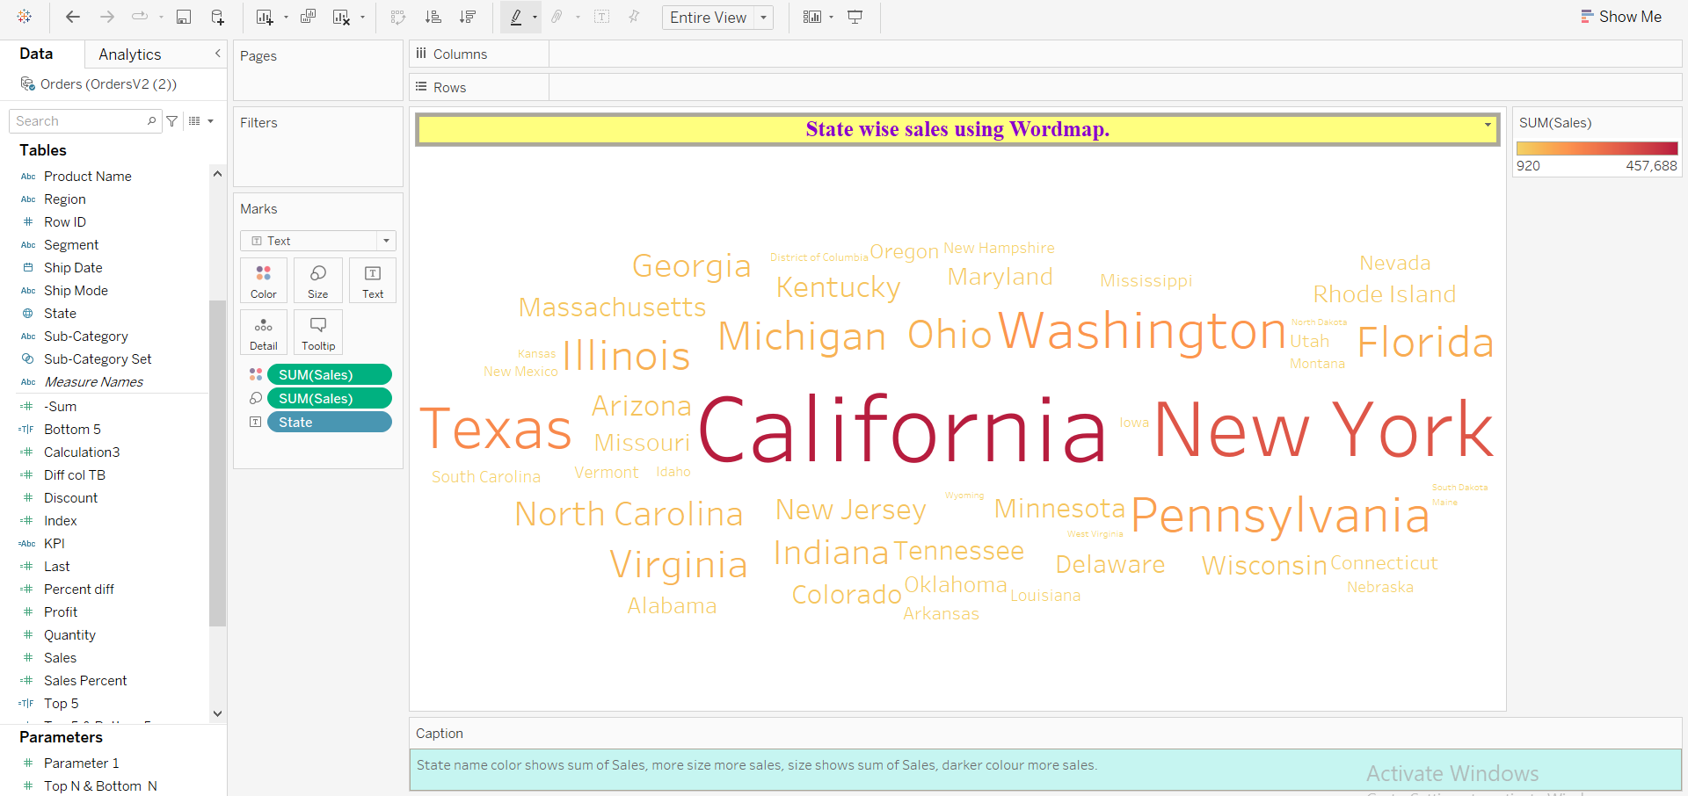
State wise sales using Word map, better view.

Slide 6
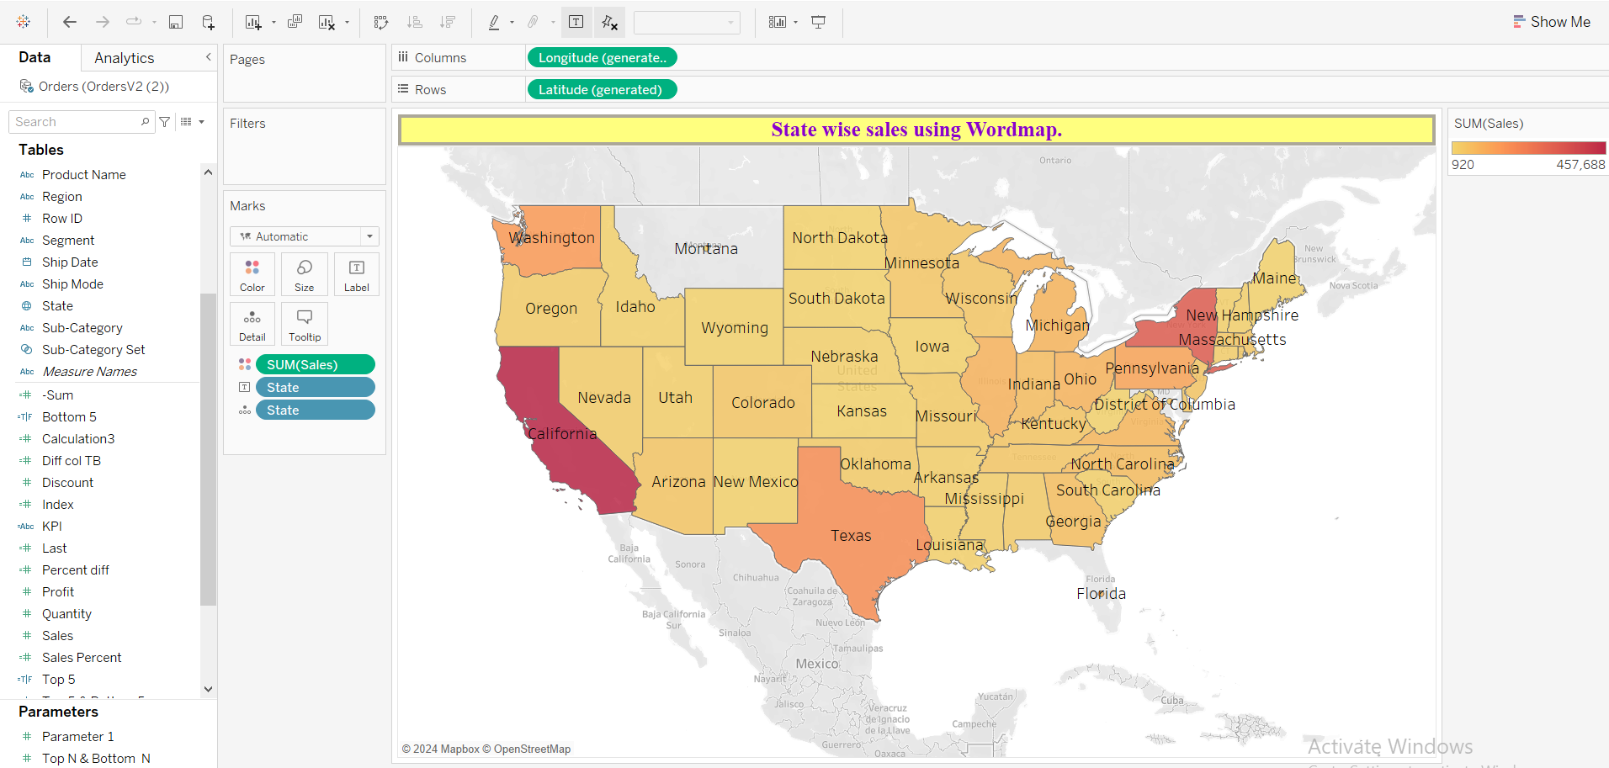
State wise sales using World map, better view.

Slide 7
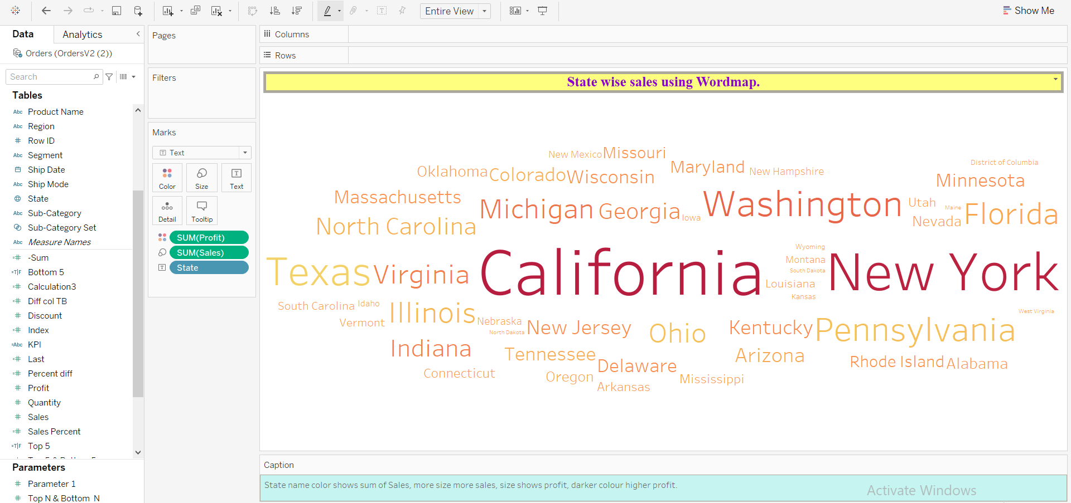
State wise sales using Word map, more relevant with profit field.

Slide 8
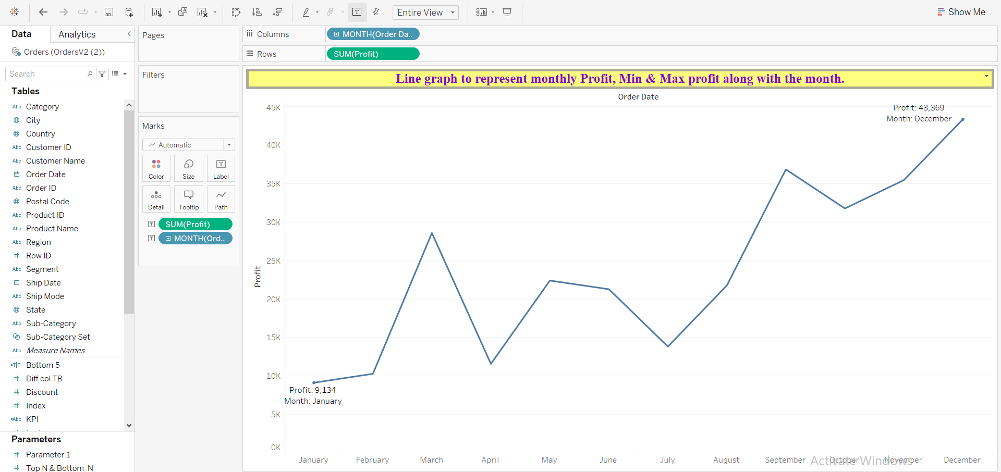
Line graph to represent monthly Profit, Min & Max profit along with the month.

Slide 9
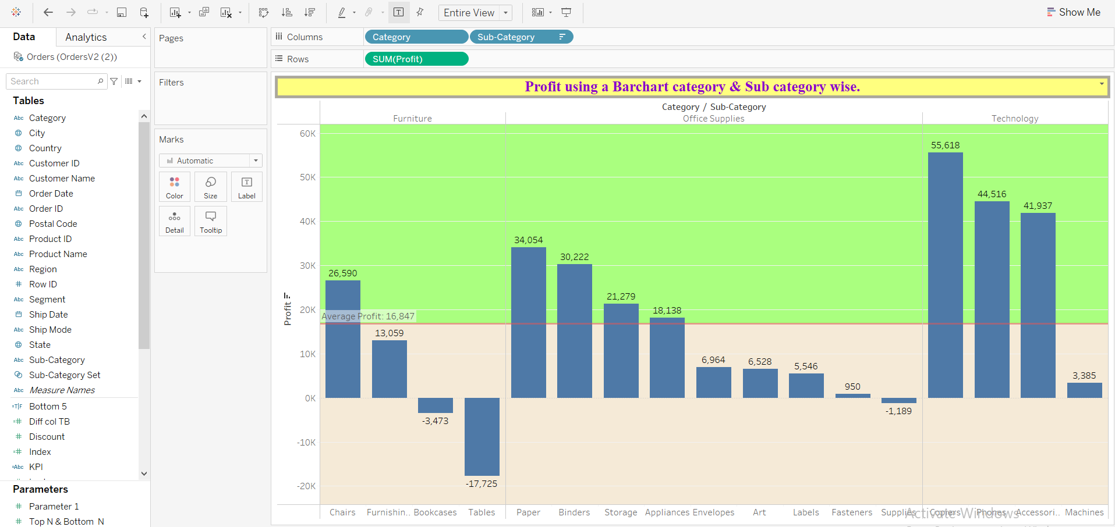
Profit using a Barchart category & Sub category wise.

Slide 10
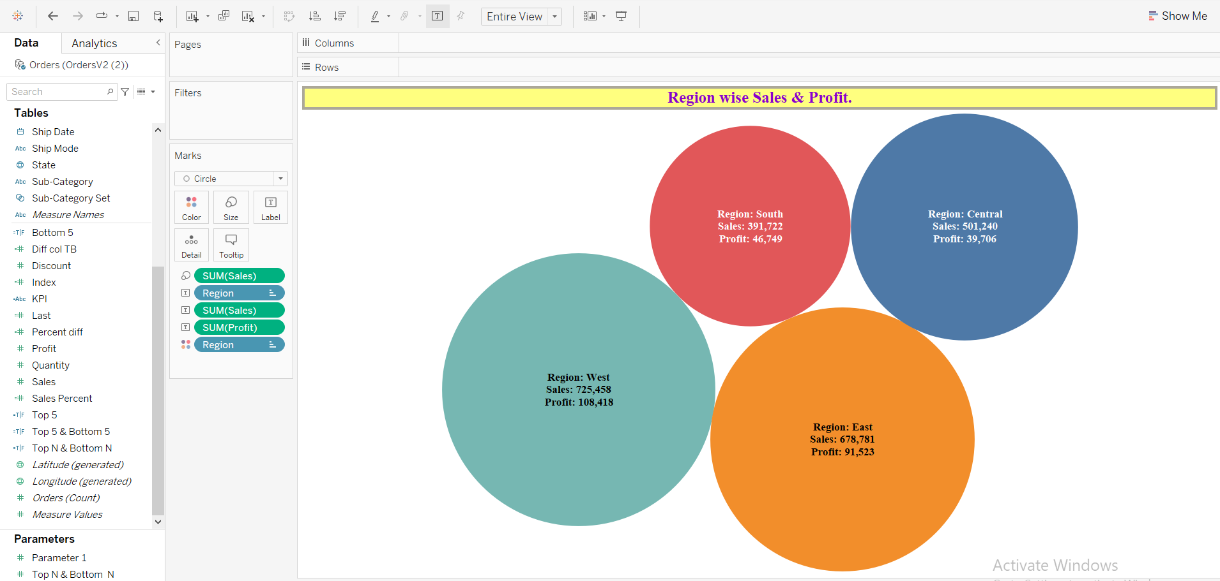
Region wise Sales & Profit.

Slide 11
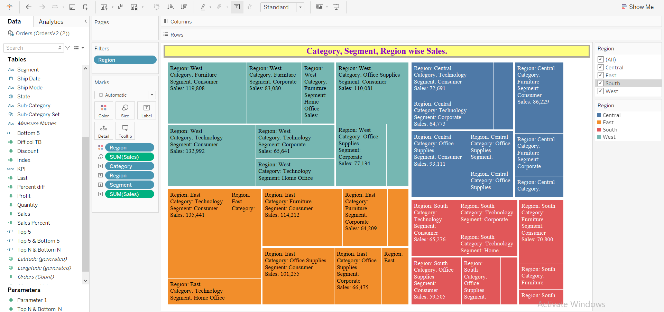
Category, Segment, Region wise Sales.

Slide 12
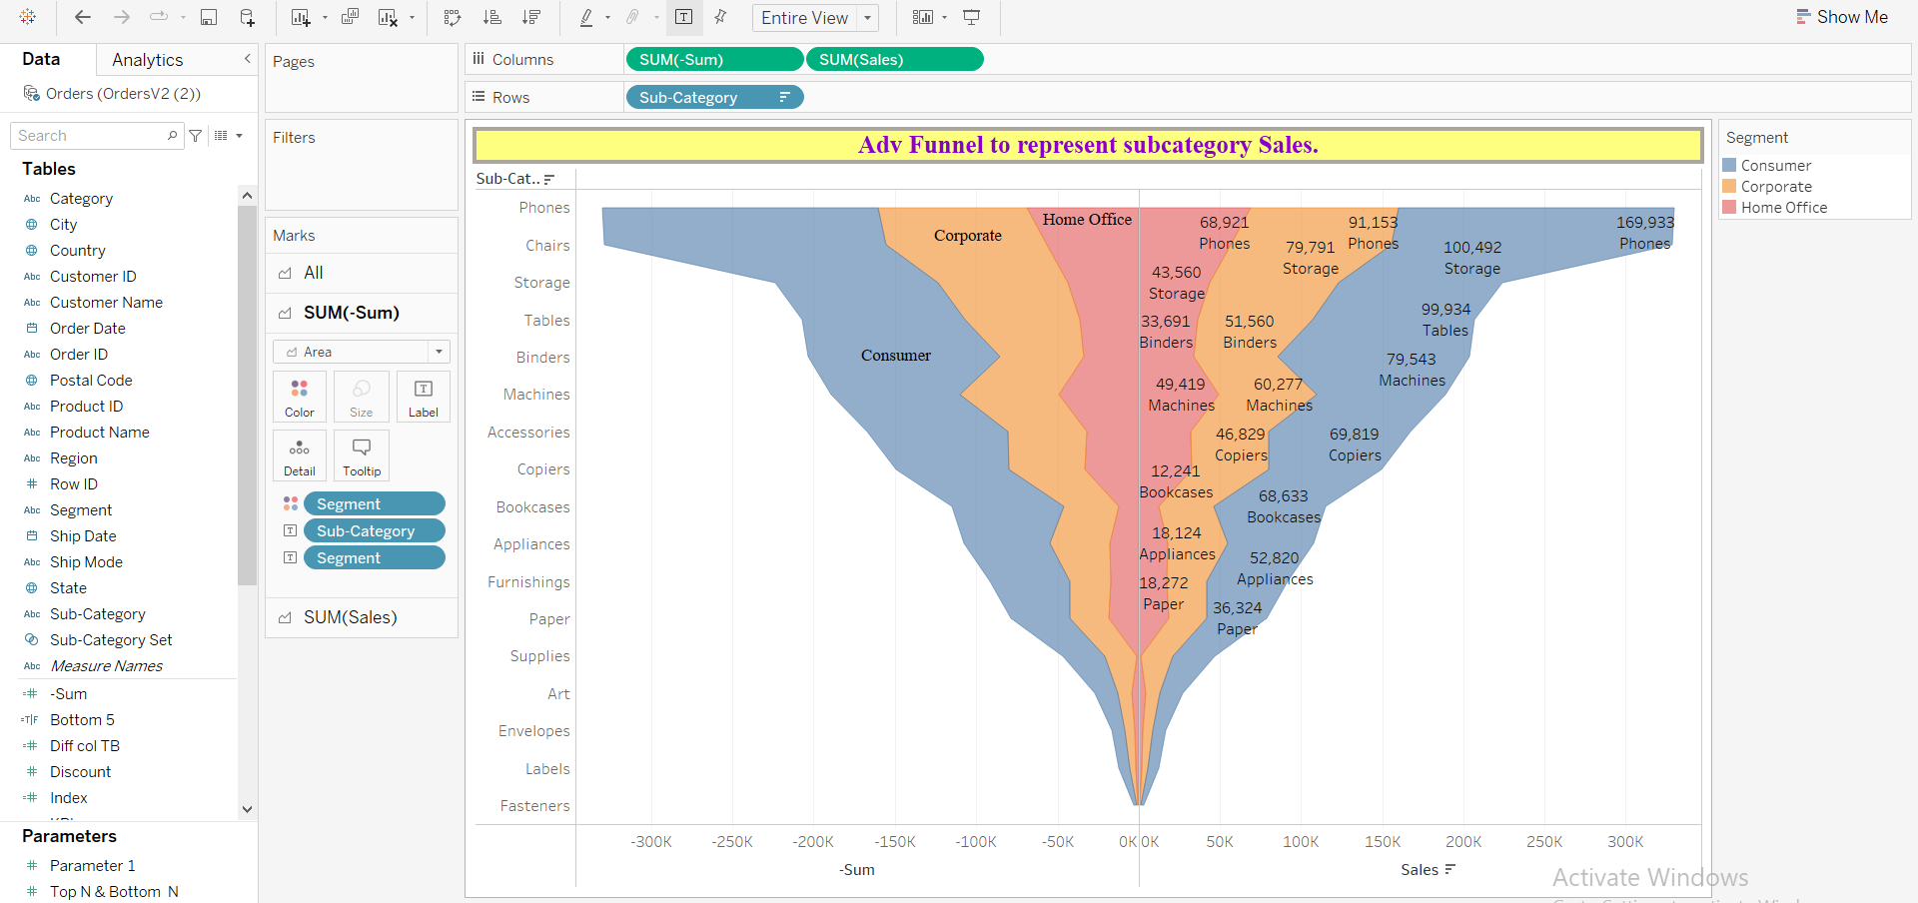
Advanced Funnel to represent subcategory Sales.

Slide 13
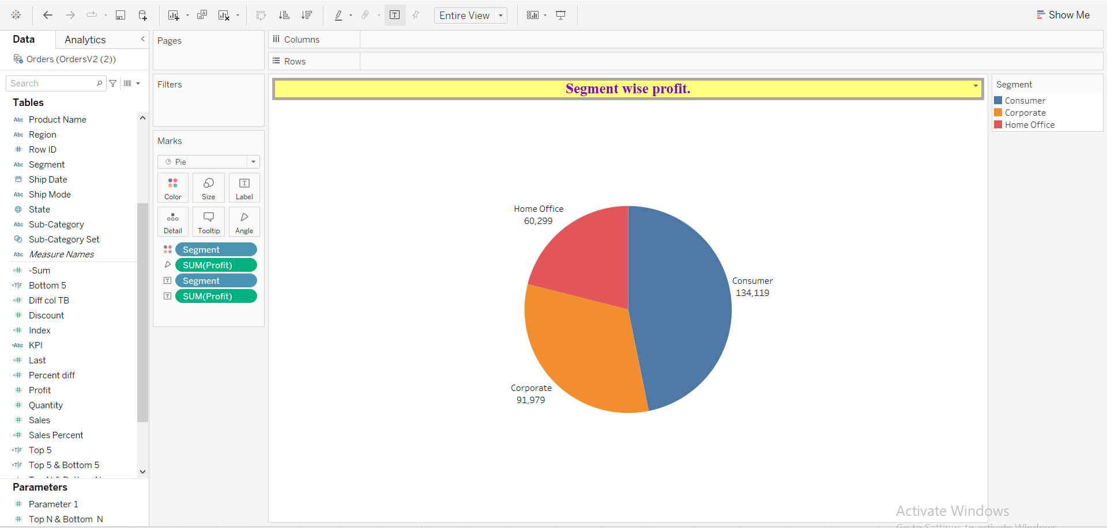
Segment wise profit.

Slide 14
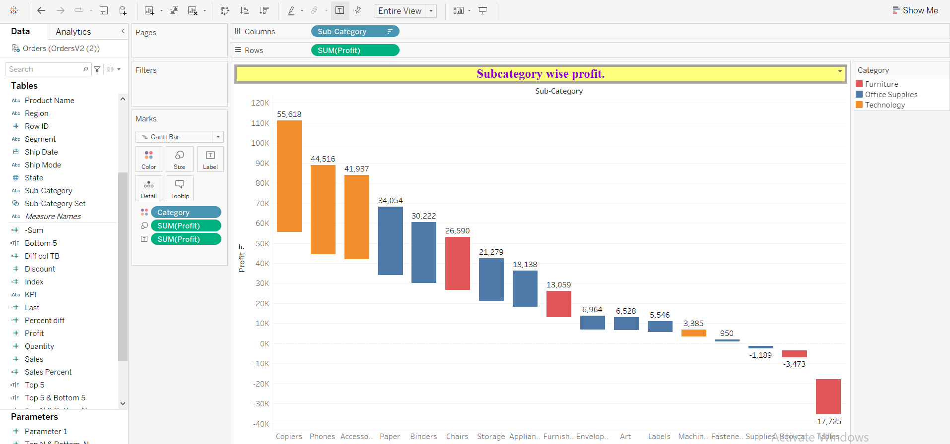
Subcategory wise profit.

Slide 15
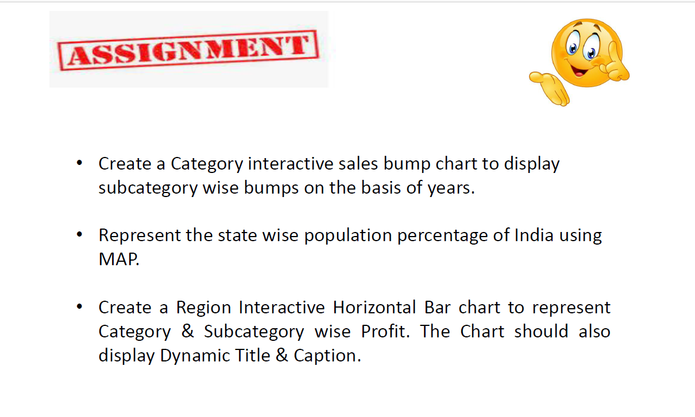
Questions:

Slide 16
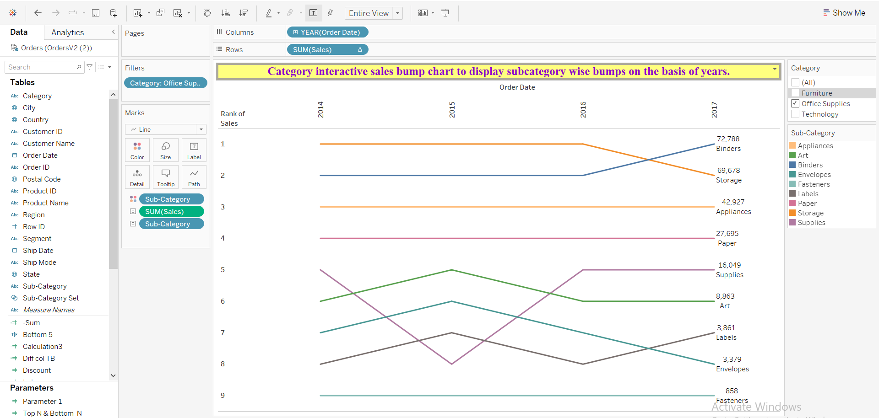
Category interactive sales bump chart to display subcategory wise bumps on the basis of years.

Slide 17
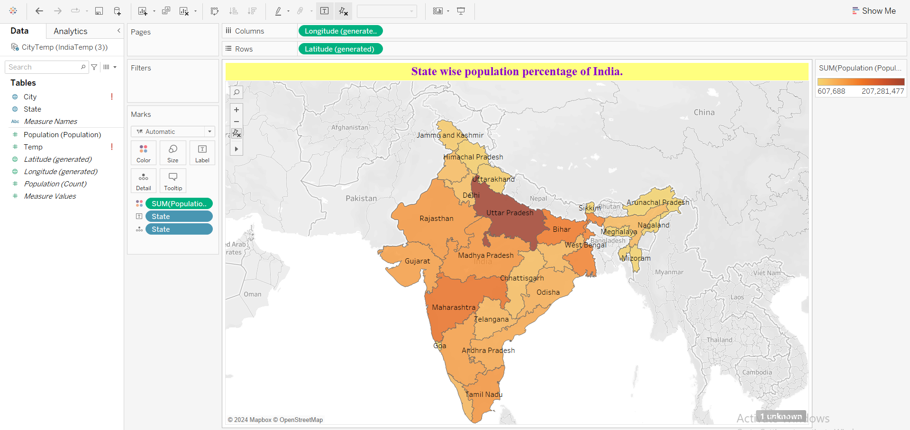
State wise population percentage of India.

Slide 18
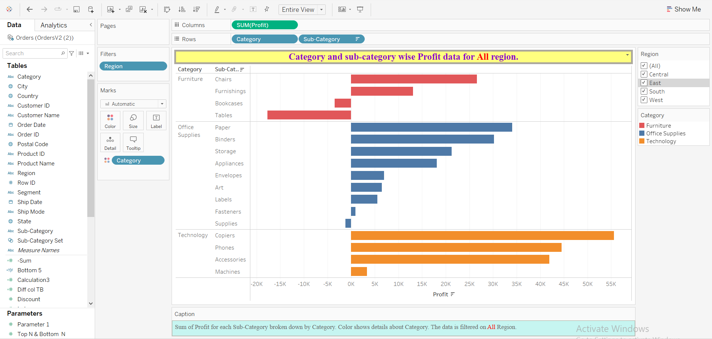
Region Interactive Horizontal Bar chart to represent Category & Subcategory wise Profit.

